Slide 1
Unlock the full potential of Azure with Bicep!
Roberto Hernández
Notes:
Unlock the full potential of your Azure cloud environment with Bicep, Microsoft's powerful Infrastructure-as-Code (IaC) language. In this session, we'll explore how Bicep simplifies the deployment of Azure resources by offering a more intuitive and readable syntax compared to traditional JSON templates. Whether you're new to Infrastructure-as-Code or looking to enhance your current deployment practices, this presentation will equip you with the knowledge and tools needed to streamline your Azure resource management using Bicep. Bring your questions and get ready to take your Azure deployments to the next level!

Slide 2
CONTENT
Infrastructure as Code (IaC)
Azure IaC Tools
Installing Bicep
Core Bicep Syntax and Features
Loops and Conditional expressions in Bicep
Code reusability in Bicep (Modules)
Bicep Best Practices
Q&A

Slide 3
Infrastructure as Code (IaC)
(What is?) Is the process of managing and provisioning computer data center resources through machine-readable definition files, rather than physical hardware configuration or interactive configuration tools. The definitions should be stored in a version control system, rather than maintaining the code through manual processes.
Principles: Automation, Repeatability, Version Control, Scalability, and Improved Security.

Slide 4
Benefits of IaC
Eliminate environment drift in release pipelines.
Eliminate manual configuration
Enforces consistency

Slide 5



IaC in Azure
Azure CLI / Posh
Imperative
Azure Resource Manager (ARM)
Declarative
JSON/XML templates.
Azure Bicep
Language
Declarative
Easier to use syntax
Existing migration path from ARM
Notes:
Showcase imperative code in Vault deployment.
Showcase declarative code in Github repository (bicep)

Slide 6
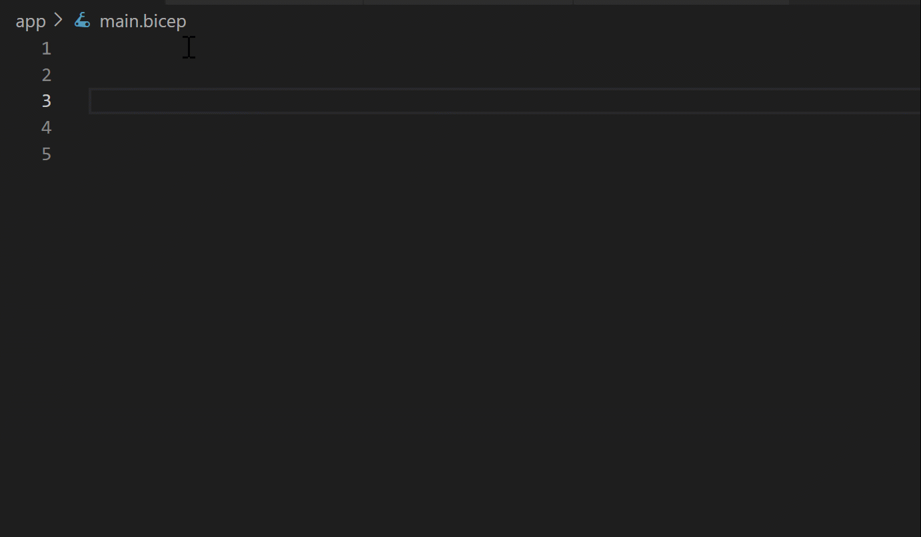
What is Azure Bicep?
Bicep is a transparent abstraction over ARM templates.
Key features and benefits (easier syntax, modularity, integration with ARM).
Notes:
From last bullet!
What is the best solution? Factors: - Team familiarity with tool.
- Current investment. - Single / Multi-Cloud Provider solution

Slide 7

Is Bicep the right tool for your team?
Factors
Does your team have an existing solution for IaC?
Is your team already familiar with another IaC tool?
Are your team deployments cross Cloud Platforms?
ARM
Bicep
Notes:
My opinion
I would always choose Bicep over ARM, because declarative code is easier to manage than imperative.
I would choose Terraform for cross cloud platform projects.

Slide 8
DEMO
Setting Up Your Environment for Bicep
Notes:
Installation
Ecosystem tools:
Decompile from existing ARM.
Playground
Visualizer

Slide 9
Core Bicep Syntax and Features
Basic Structure: Declare and initialize resources with Bicep.
Variables and Parameters: Using variables and parameters for dynamic values.
Outputs: Defining and using outputs.
Expressions and Loops: Advanced syntax for handling complex requirements.

Slide 10
DEMO
Core Bicep Syntax and Features

Slide 11
DEMO
Looping and Conditionals Bicep Syntax and Features
Notes:
Installation: Quick installation and setup for Bicep CLI and VS Code extension.
How to keep Bicep CLI updated.
Demo: Setting up and verifying Bicep in a development environment.

Slide 12
Bicep Modules and Reusability
Organize code and make it reusable.
Use and share modules across different projects within your organization.
Use modules from the Azure Verified Modules (AVM) repository.
module stgModule '../storageAccount.json' = {
name: 'storageDeploy’
params: {
storagePrefix: 'examplestg1’
}
}

Slide 13
Azure Verified Modules
Initiative to consolidate and set the standards for what a good Infrastructure-as-Code module looks like.
Modules will then align to these standards, across languages (Bicep, Terraform etc.) and will then be classified as AVMs and available from their respective language specific registries.
@description(Storage accounts using an AVM.’)
module storage 'br/public:avm/res/storage/storage-account:0.9.0' = {
name: 'myStorage’
params: {
name: 'store${resourceGroup().name}’
}
}
https://azure.github.io/Azure-Verified-Modules/
Notes:
Best Practices out of the box:
For example:
Lockdown (Keyvault, Storage)
Redundancy.

Slide 14
DEMO
Bicep Modules and Reusability

Slide 15
DEMO
Looping and Conditionals Bicep Syntax and Features
Notes:
Installation: Quick installation and setup for Bicep CLI and VS Code extension.
How to keep Bicep CLI updated.
Demo: Setting up and verifying Bicep in a development environment.

Slide 16
Best Practices (Parameters)
Naming
Name should be readable.
Document
Use the description attributes to expand as appropriate.
@allowed
Use the allowed attribute sparingly as the constraints may become obsolete quickly.

Slide 17
Best Practices (Resources) – Part 01
Naming
Use camel case for variables and resources. For resources specifically try to follow the Azure Naming guidelines without sacrificing uniqueness.
Unique
Use the built-in uniqueString function to prevent name clashes across your environments.

Slide 18
Best Practices (Resources) – Part 02
Complex
Expressions
Instead of embedding complex expressions directly into resource properties, use variables to contain the expressions.
API Versions
New features in Azure services are sometimes available only in newer API versions.
DependsOn
Prefer using implicit dependencies over explicit dependencies.
Nesting
Avoid nesting too many layers deep.

Slide 19
Best Practices (Output Parameters)
Sensitive Data
Make sure you don't create outputs for sensitive data. Output values can be accessed by anyone who has access to the deployment history. They're not appropriate for handling secrets.
Instead of passing property values around through outputs, use the existing keyword to look up properties of resources that already exist. It's a best practice to look up keys from other resources in this way instead of passing them around through outputs. You'll always get the most up-to-date data.

Slide 20
DEMO
Walkthrough some of the Best Practices in the Demo Code

Slide 21
THE END
Roberto Hernandez roberto.hernandez@infernored.com
https://github.com/overridethis/bicep-walkthrough

